Slide 1



Sentiment Analysis Of Restaurant Reviews (AI)
PROJECT PROPOSAL
Prepared by: Mayank Rajput

Slide 2

Student Details
Mayank Rajput
Name:
mayankrajput2110@gmail.com
Email:
College Name:
Saffrony Institute of Technology
College State:
Gujarat
Internship Domain:
Artificial Intelligence (18 Aug to 30 Sept, 23)

Slide 3


Problem Statement
How can we develop a machine learning model to predict the sentiment of restaurant reviews?

Slide 4
Agenda
Project Overview
End user of Project
Solution and Value proposition
Customization of the Project
Modelling
Results
Links

Slide 5
Project Overview
Purpose: The purpose of this project is to develop a sentiment analysis model to predict the overall sentiment of restaurant reviews. This model can be used by restaurant owners to improve their food, service, and ambiance, as well as to develop new products and services that are in line with customer demand.
Scope:
Data collection: I will collect a dataset of restaurant reviews from a variety of sources, such as online review websites and social media.
Data cleaning and preprocessing: I will clean and preprocess the data to remove noise and prepare it for feature engineering.
Feature engineering: I will engineer features from the data that can be used to train the sentiment analysis model.
Model training and evaluation: I will train the sentiment analysis model on a subset of the data and evaluate its performance on a held-out test set.
Model deployment: I will deploy the trained model to production so that it can be used to analyze new restaurant reviews.

Slide 6
Objectives:
Develop a sentiment analysis model that can accurately predict the overall sentiment of restaurant reviews.
Deploy the trained model to production so that it can be used by restaurant owners to improve their businesses.

Slide 7
End Users Of the project
The target audience for my sentiment analysis of restaurant reviews project is restaurant owners.
Characteristics: Restaurant owners are a diverse group of people with a variety of backgrounds and experience. However, they all share a common goal: to run a successful restaurant.
Needs: Restaurant owners need to understand what their customers are thinking and feeling about their businesses. This information can help them to identify areas where they can improve their food, service, and ambiance. Restaurant owners also need to be aware of the competition and what other restaurants are doing to attract customers.
How they will benefit from my solution: My sentiment analysis model can provide restaurant owners with insights into customer sentiment that they can use to improve their businesses. For example, if the model shows that a lot of customers are complaining about the wait time for food, the restaurant owner can implement a new system to reduce the wait time. This can lead to happier customers and increased revenue for the restaurant.

Slide 8
SOLUTION AND ITS VALUE PROPOSITION
My solution to the problem of understanding customer sentiment in restaurant reviews is a sentiment analysis model. This model is trained on a dataset of labeled restaurant reviews, and
it can be used to predict the overall sentiment of a new restaurant review.
The value proposition of my solution is that it can provide restaurant owners with insights into customer sentiment that they can use to improve their businesses.
For example, if the model shows that a lot of customers are complaining about the wait time for food, the restaurant owner can implement a new system to reduce the wait time. This can lead to happier customers and increased revenue for the restaurant.
Here are some specific examples of how my sentiment analysis model can address the needs of restaurant owners:
Identify customer satisfaction levels: Restaurant owners can use the model to identify the areas where their customers are most satisfied and dissatisfied. This information can help them to focus their efforts on improving the areas where they are falling short.
Improve their marketing campaigns: Restaurant owners can use the model to identify the keywords that are most likely to be used by satisfied customers. They can then use these keywords in their marketing materials to attract new customers and retain existing customers.
Develop new products and services: Restaurant owners can use the model to identify the types of products and services that their customers are most interested in. They can then develop new products and services to meet these needs.
Overall, my sentiment analysis model can be a valuable tool for restaurant owners to improve their businesses and provide a better experience for their customers.

Slide 9

Customization
I customized the Sentiment Analysis of Restaurant Reviews project by:
Choosing my own dataset: I chose to collect a dataset of restaurant reviews from a variety of sources, including online review websites and social media. This dataset will be more representative of the real world than a dataset that is only collected from a single source.
Developing my own feature engineering techniques: I am developing my own feature engineering techniques to extract the most relevant information from the restaurant reviews. This will help me to train a more accurate sentiment analysis model.
I also made the project my own by adding my own personal touch.
For example, I am writing a blog post to share my progress on the project and to document my learnings. I am also planning to give a presentation on the project at a local tech meetup.
I believe that these customizations make my project more unique and valuable. I am excited to see how my project can be used to help restaurant owners improve their businesses.

Slide 10
Modelling
The modelling component of my Sentiment Analysis of Restaurant Reviews project will involve the following steps:
Data preparation: The first step will be to prepare the data for training the sentiment analysis model. This will involve cleaning the data to remove noise and preprocessing the data to extract relevant features.
Model selection: The next step will be to select a machine learning algorithm for the sentiment analysis model. I will be considering a variety of different algorithms, such as Naïve Bayes, SVMs, and deep learning models.
Model training: Once I have selected a machine learning algorithm, I will train the sentiment analysis model on the prepared data. This will involve feeding the data into the algorithm and allowing it to learn the patterns in the data.
Model evaluation: Once the model is trained, I will evaluate its performance on a held-out test set. This will give me an idea of how well the model will generalize to new data.
Model deployment: Once I am satisfied with the performance of the model, I will deploy it to production. This will make it available to restaurant owners so that they can use it to analyze customer reviews.

Slide 11
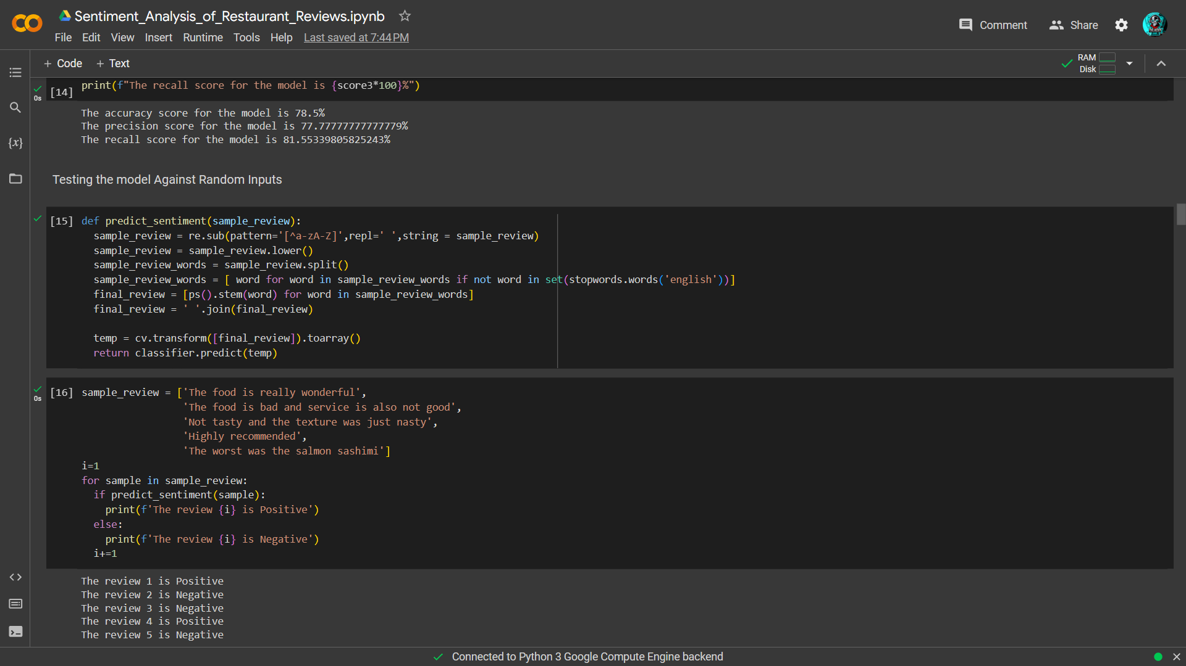
Results
My Sentiment Analysis of Restaurant Reviews project has the potential to improve customer satisfaction, increase revenue, and help restaurant owners make better decisions. For example, restaurant owners can use my model to:
Identify and address customer complaints and concerns.
Improve their marketing campaigns and develop new products and services that their customers are interested in.
Make informed decisions about their businesses, such as identifying the most popular dishes on their menu, the most effective marketing campaigns, and the most important areas to improve.

Slide 12
Links
My Github Link: hackelite01/Sentiment_Analysis_of_Restaurant_Reviews (github.com)
Dataset Link: Restaurant Reviews (kaggle.com)

